Slide 1
Simulation of Butterfly Coloration and Evolution in a Dynamic Environment

Slide 2
Objective of the Simulation
Goal: Model the evolution of butterfly populations based on coloration, camouflage effectiveness, and predation.
Key Features:
Interaction between butterflies, predators, and the environment.
Effect of camouflage on survival rates.
Dynamics of reproduction and food availability.

Slide 3
Table of contents
01
02
03
04
05
06
Simulation of Butterfly Coloration and Evolution in a Dynamic Environment
Butterfly Agent Class
You can describe the topic of the section here
You can describe the topic of the section here
You can describe the topic of the section here
You can describe the topic of the section here

Slide 4
Presentator: Nguyen Tu Tung StudentID: M23.ICT.012

Slide 5
Global Settings and Initialization
Global Parameters:
grid_size: 100x100 grid.
Initial populations: 30 butterflies, 10 predators, 15 food items.
initial_energy: Energy level for creatures.
Adjustable Variables:
predation_intensity (0.1 to 1.0).
reproduction_rate (0.1 to 1.0).
Initialization:
Butterflies, predators, and food are created at the start.
Environment grid cells are assigned random colors (Black, White, Gray).

Slide 6
Environmental Grid
Cells have attributes:
cell_color: Randomly assigned (Black, White, Gray).
is_free: Availability of the cell.
has_food: Presence of food.
Visualization:
Food cells: Green.
Black, White, Gray cells: Represent camouflage environments.

Slide 7
Butterfly Species
Attributes
Behaviors
color: Black, White, or Gray.
camouflage_score: Determines predation survival.
energy, age, max_lifetime, eggs_laid.
Move to find food and avoid predators.
Lay eggs based on energy and lifetime.
Compute camouflage effectiveness based on environment color.

Slide 8
Predator Species
Attributes
Behaviors
detection_range: Range for detecting butterflies.
hunt_probability: Base probability of successful predation.
energy_gain: Energy restored after hunting.
Hunt butterflies based on camouflage score and distance.
Random movement if no prey is nearby.
Energy decay over time, leading to death if depleted.

Slide 9
Food Species
Attributes
Behaviors
lifespan: Number of cycles food remains available.
is_regenerated: Indicates if food has been regenerated.
Decay after lifespan ends.
Regenerate in new cells if needed.
Provide energy to butterflies when consumed.

Slide 10
Simulation Logic
Population Tracking:
Count and record butterfly populations by color.
Monitor camouflage effectiveness.
Cycle-Based Reflexes:
Food regeneration every 30 cycles.
Aging, energy loss, and death for all species.
Predation attempts based on camouflage and predation intensity.

Slide 11
GUI Experiment
Interactive Parameters:
Visual Outputs
Adjust predation intensity and reproduction rate.
Environment grid with species represented by shapes and colors.

Slide 12
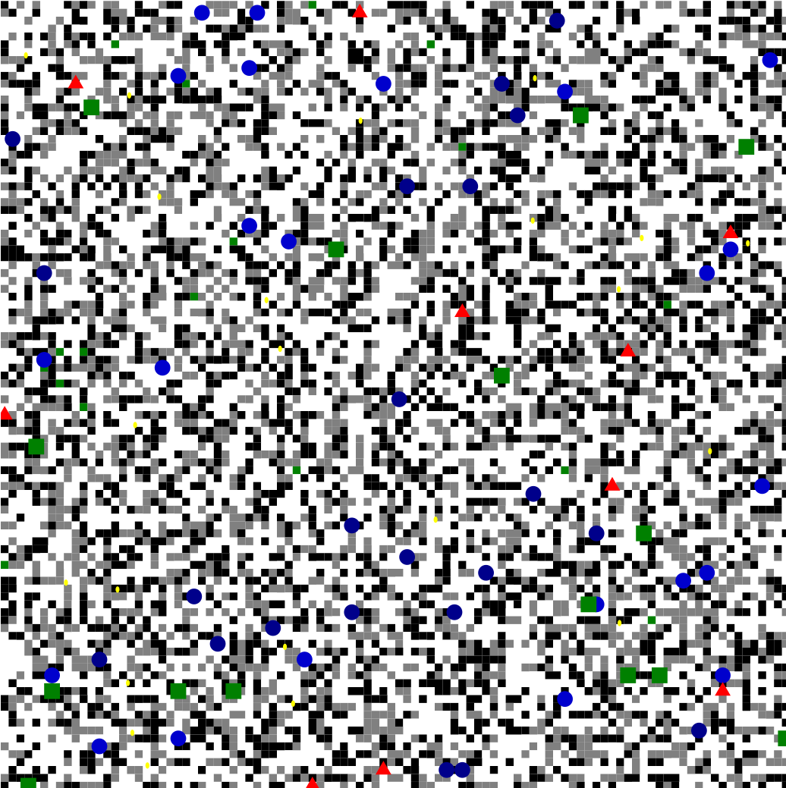
Grid visualization

Slide 13
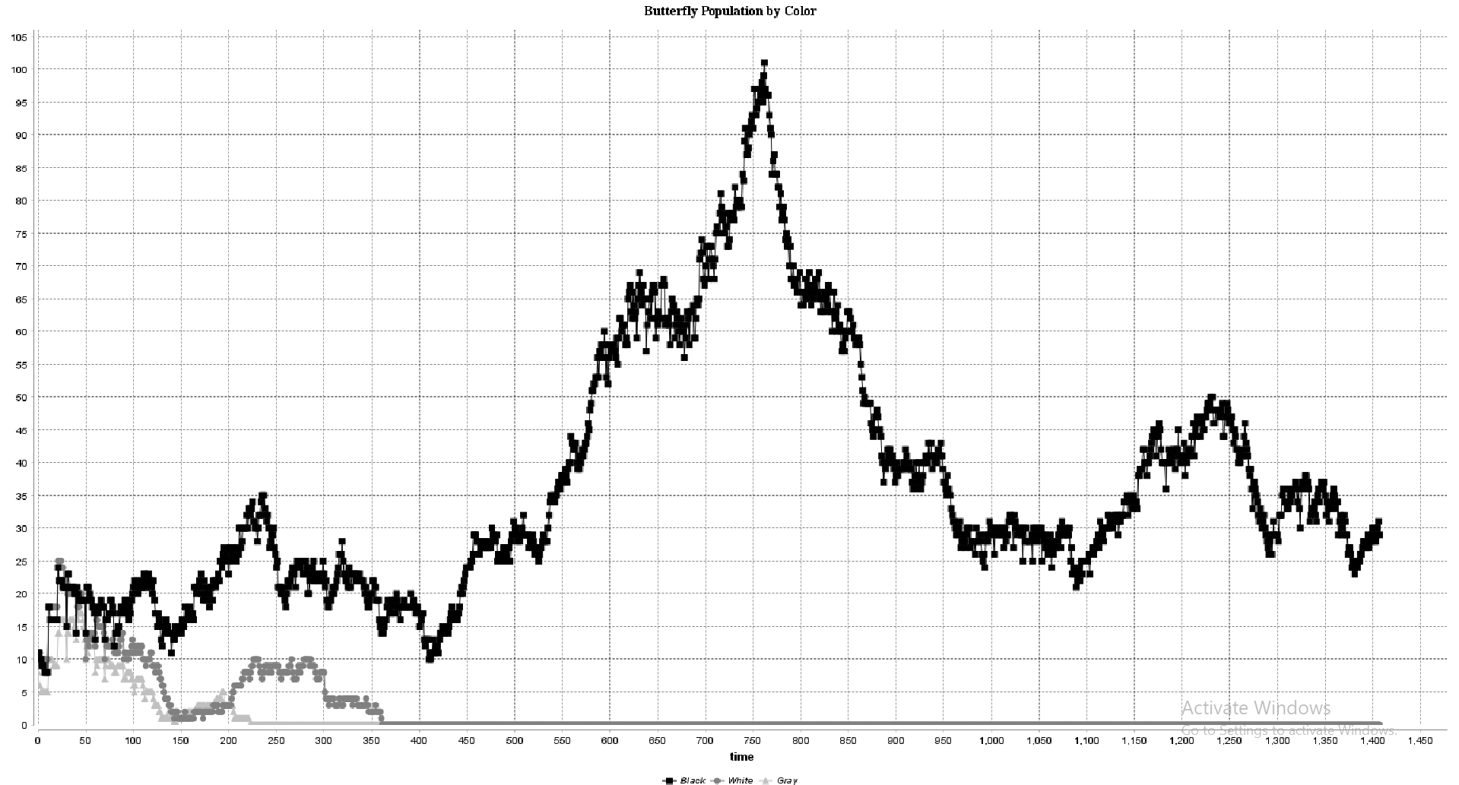
Population by color.

Slide 14
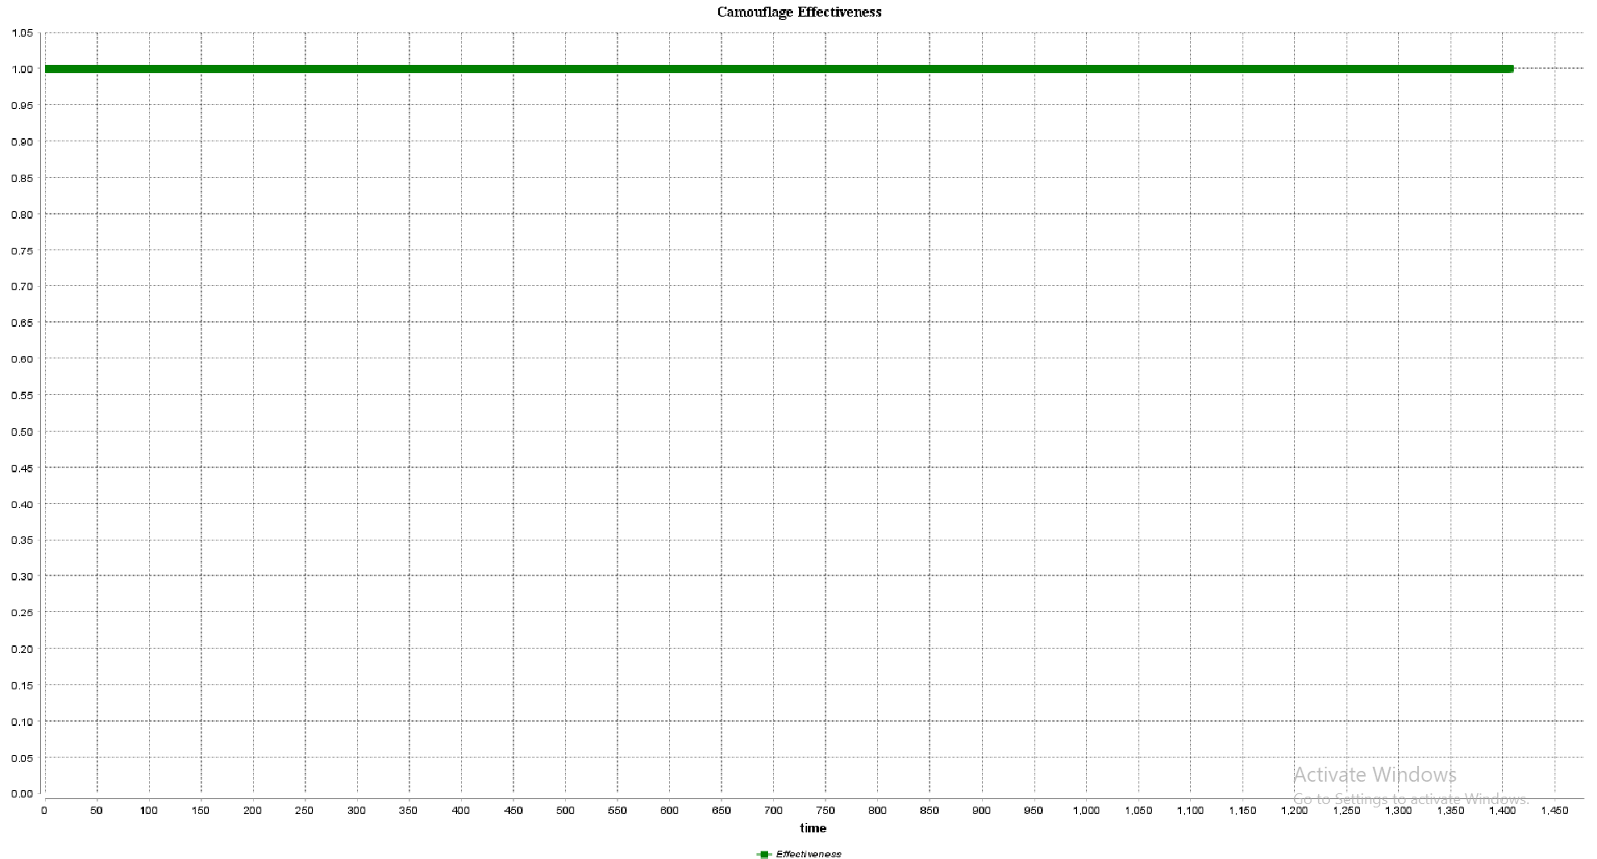
Camouflage effectiveness.

Slide 15
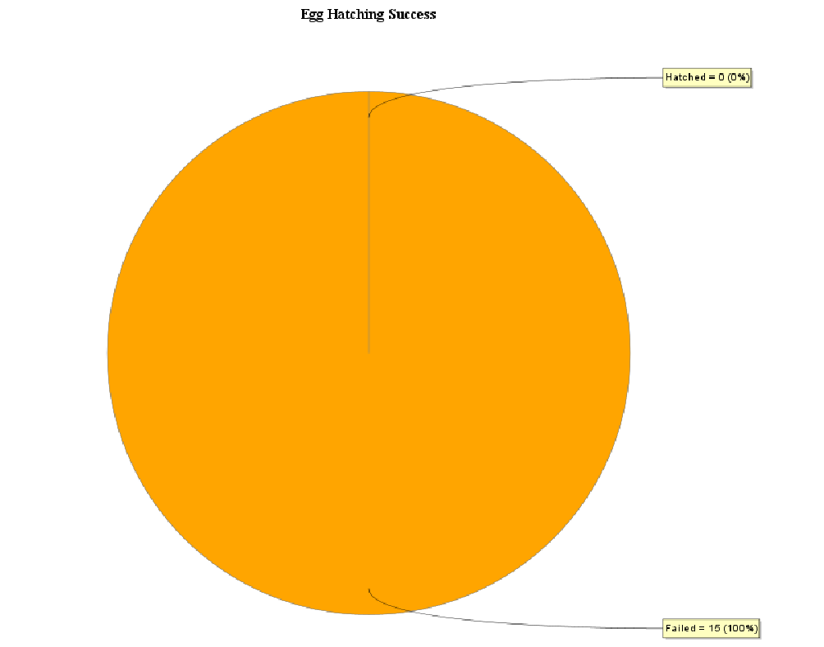
Egg hatching success (hatched vs. failed).

Slide 16
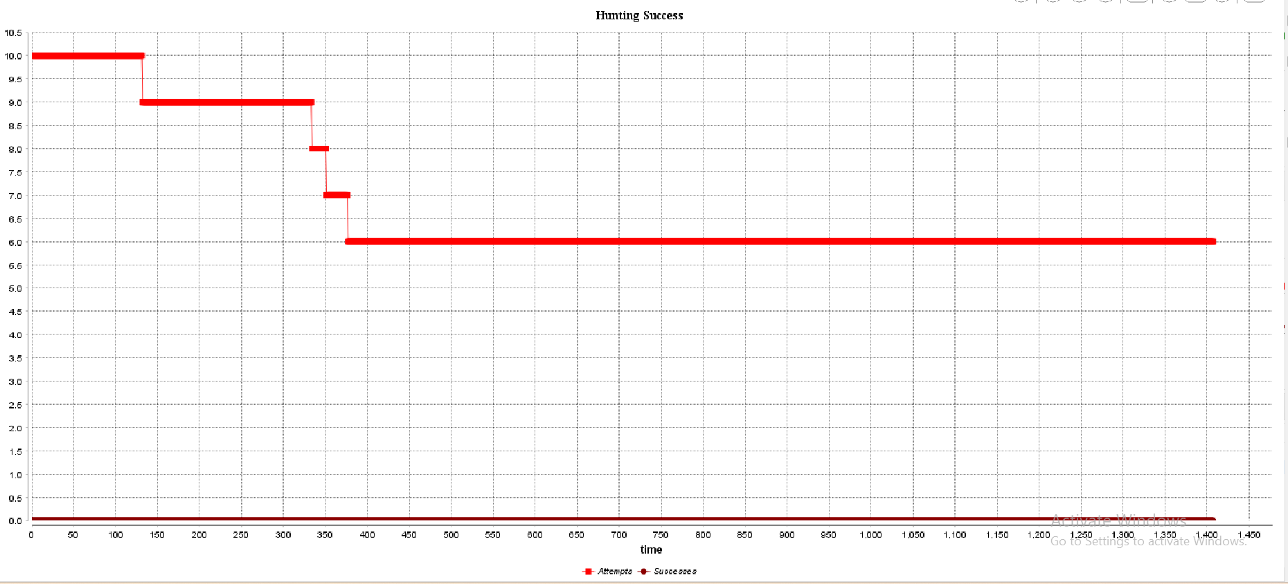
Hunting success (attempts vs. successes).

Slide 17
Ex 1 - Predator Preference for Most Represented Color
Key Concept
Code Implement
Impact
Predators target the most abundant butterfly color in the population.
Added a reflex in the global section to track the most represented color (most_represented_color).
Predators adjust their hunting behavior based on this value.
Dynamic shifts in predation pressure lead to changes in population proportions.
Increased evolutionary pressure on abundant color morphs.

Slide 18
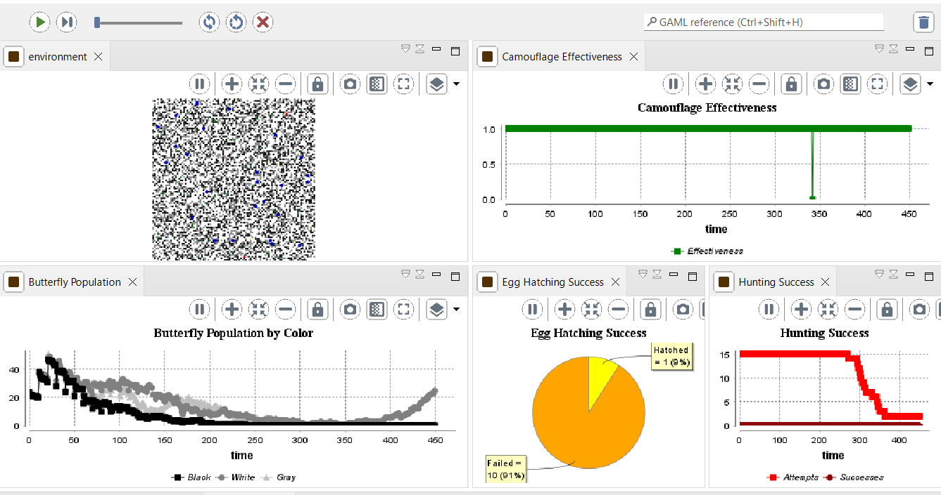
Ex1- Visualization

Slide 19
Ex 2 - Dynamic Environmental Transitions
Key Concept
Code Implement
Impact
Environmental patches change color over time at a defined speed (patch_transition_speed).
Added a reflex (update_color) in the environment_grid species for patch color transitions.
Tracked patch color proportions over time (black_patches, white_patches, gray_patches).
Dynamic environments influence butterfly camouflage effectiveness.
Promotes the emergence and persistence of diverse morphs.

Slide 20
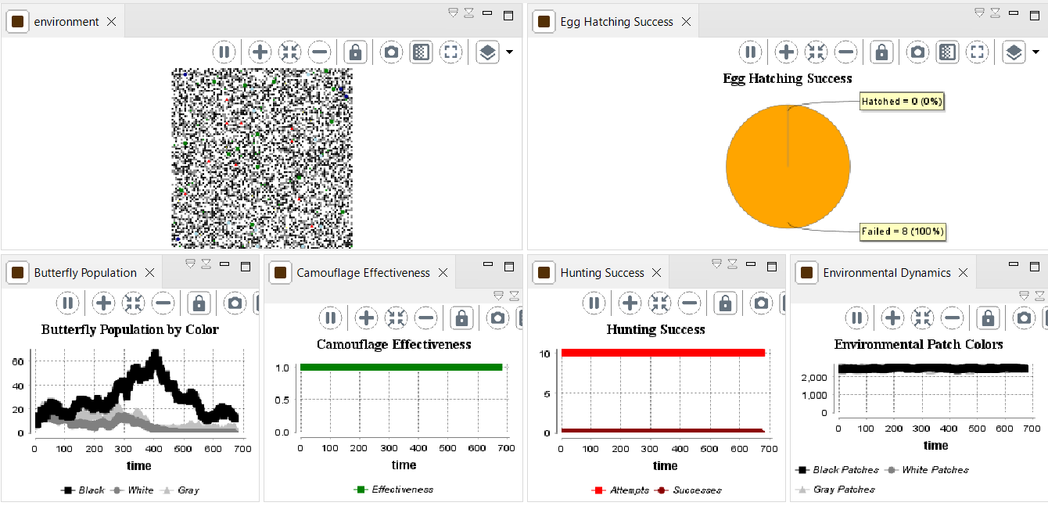
Ex2- Visualization

Slide 21
Ex 3 - Varying Predation Intensity
Key Concept
Code Implement
Impact
Predation intensity (predation_intensity) varies, simulating different ecological conditions.
Predation success probability incorporates predation_intensity.
Parameters in the GUI allow user-controlled adjustment of predation intensity.
High intensity: Faster elimination of poorly camouflaged morphs.
Low intensity: Greater survival and diversity.

Slide 22
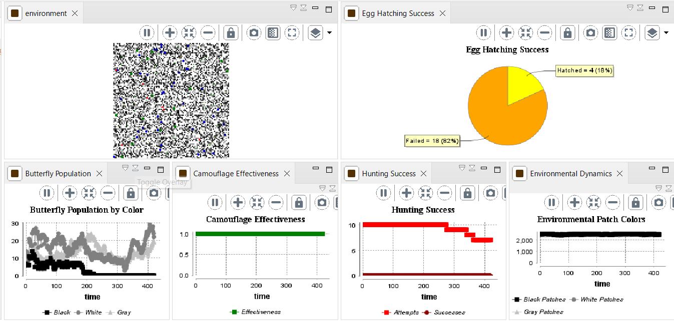
Ex3- Visualization

Slide 23
Observations and Hypotheses
Extension 1: Most represented color faces higher predation risk, leading to oscillations in population proportions.
Extension 2: Faster environmental transitions may prevent morph specialization, while slower changes favor stable adaptations.
Extension 3: Varying predation intensity influences selection pressure and population stability.

Slide 24
Conclusion
Insights
Future Enhancements
Introduce genetic inheritance for butterfly colors.
Explore predator adaptations or migrations.
Integration of behavioral and environmental dynamics enhances realism.
Highlights complex interactions driving natural selection.

